Slide 1


Slide 2
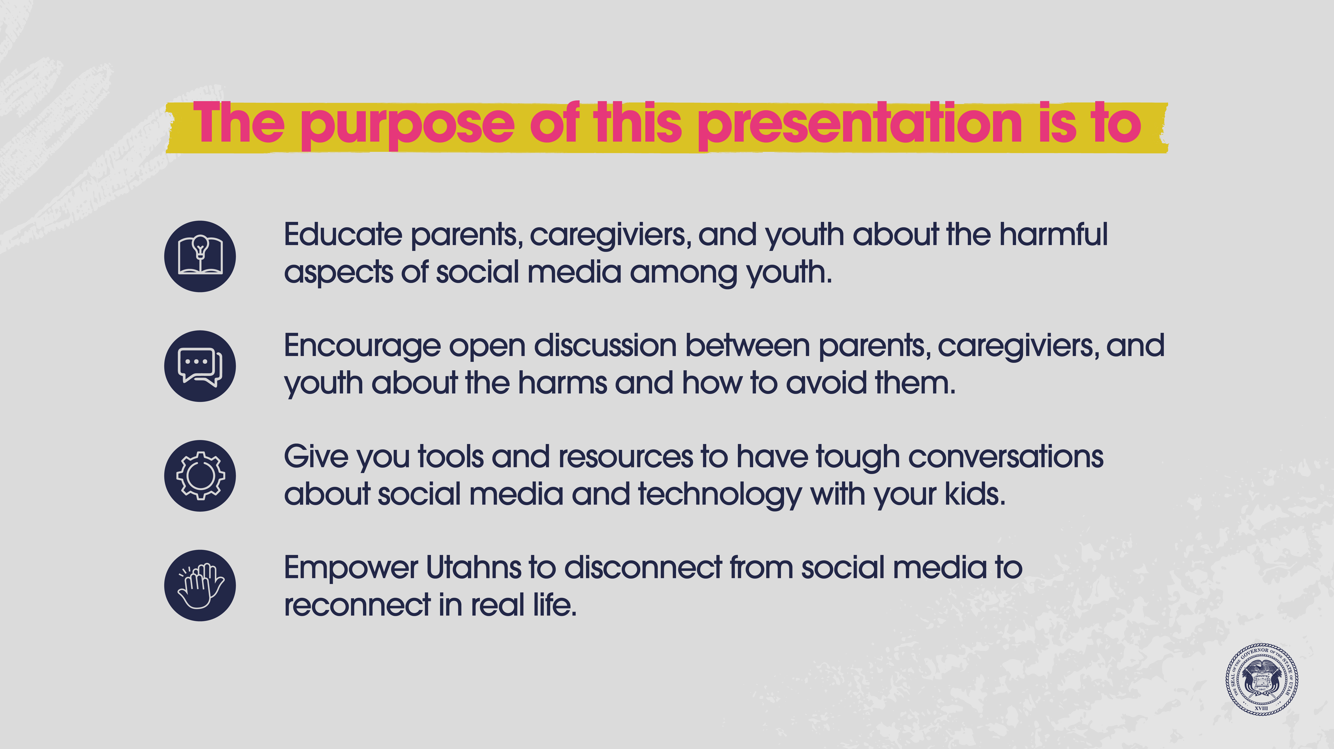

Slide 3
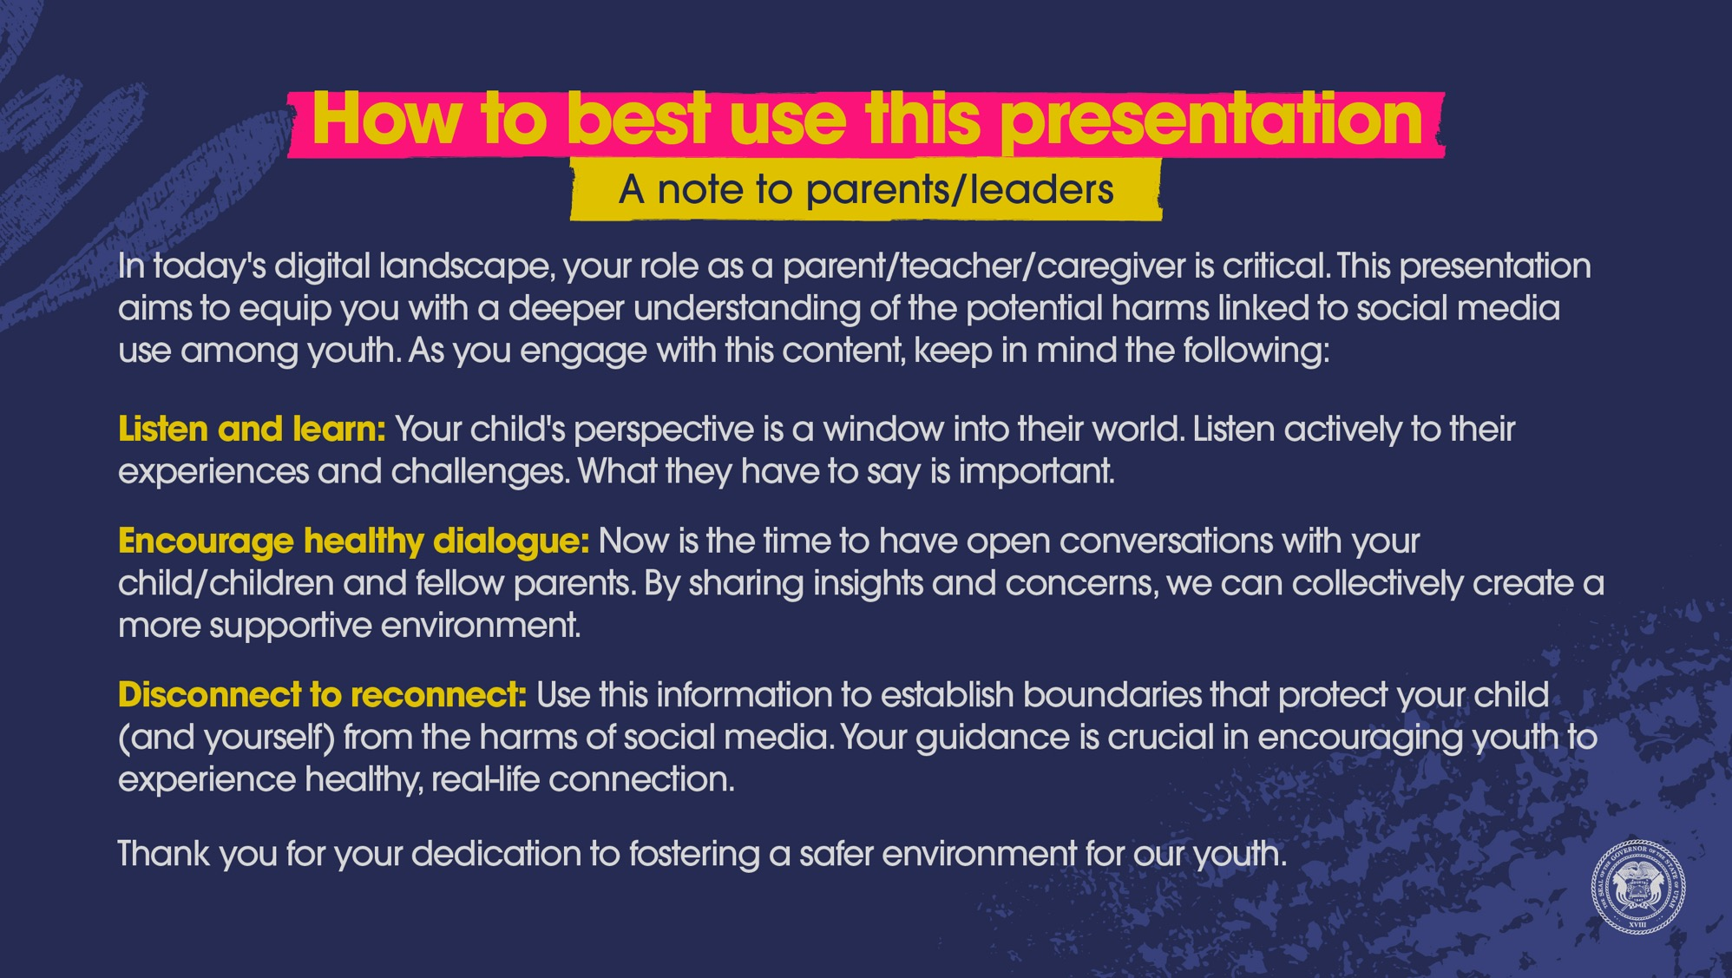

Slide 4
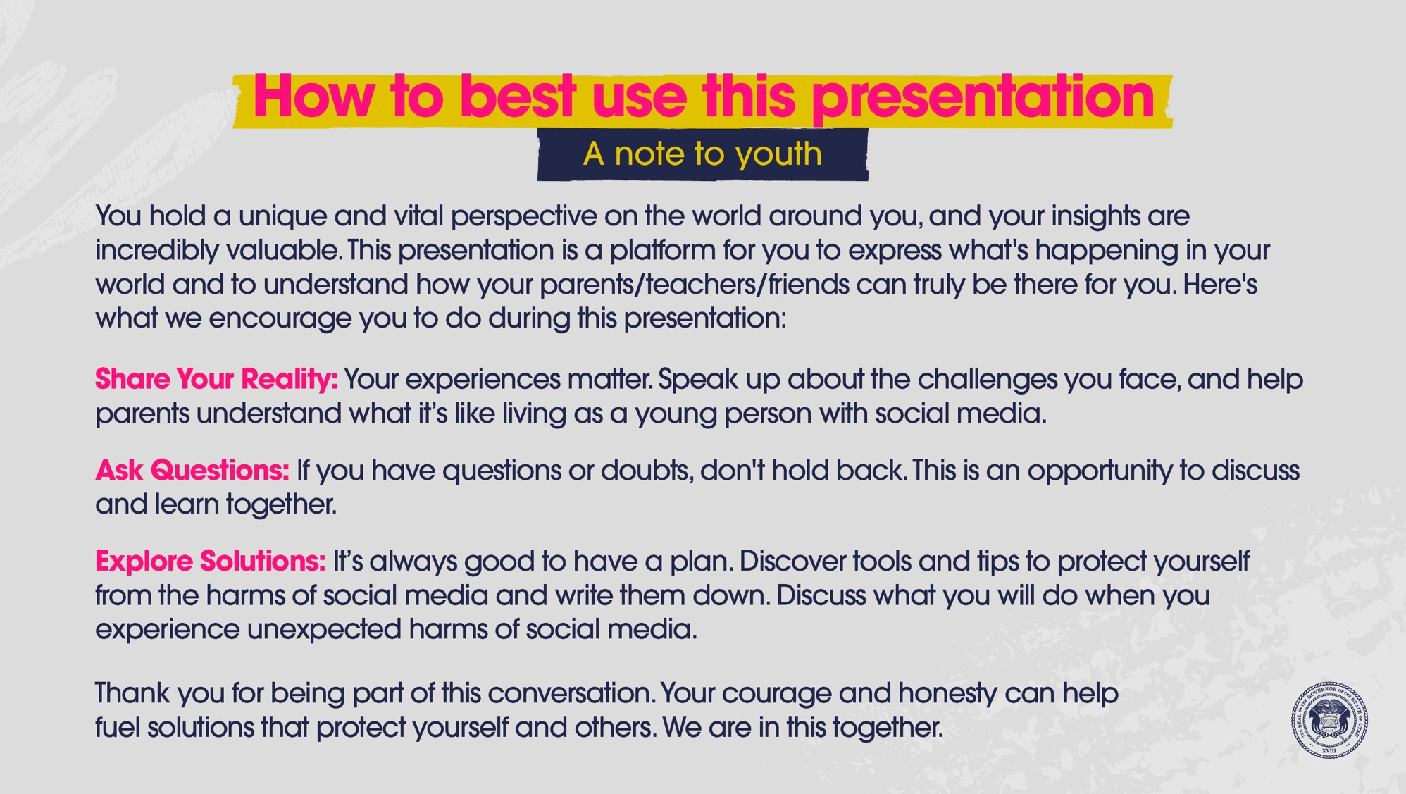

Slide 5
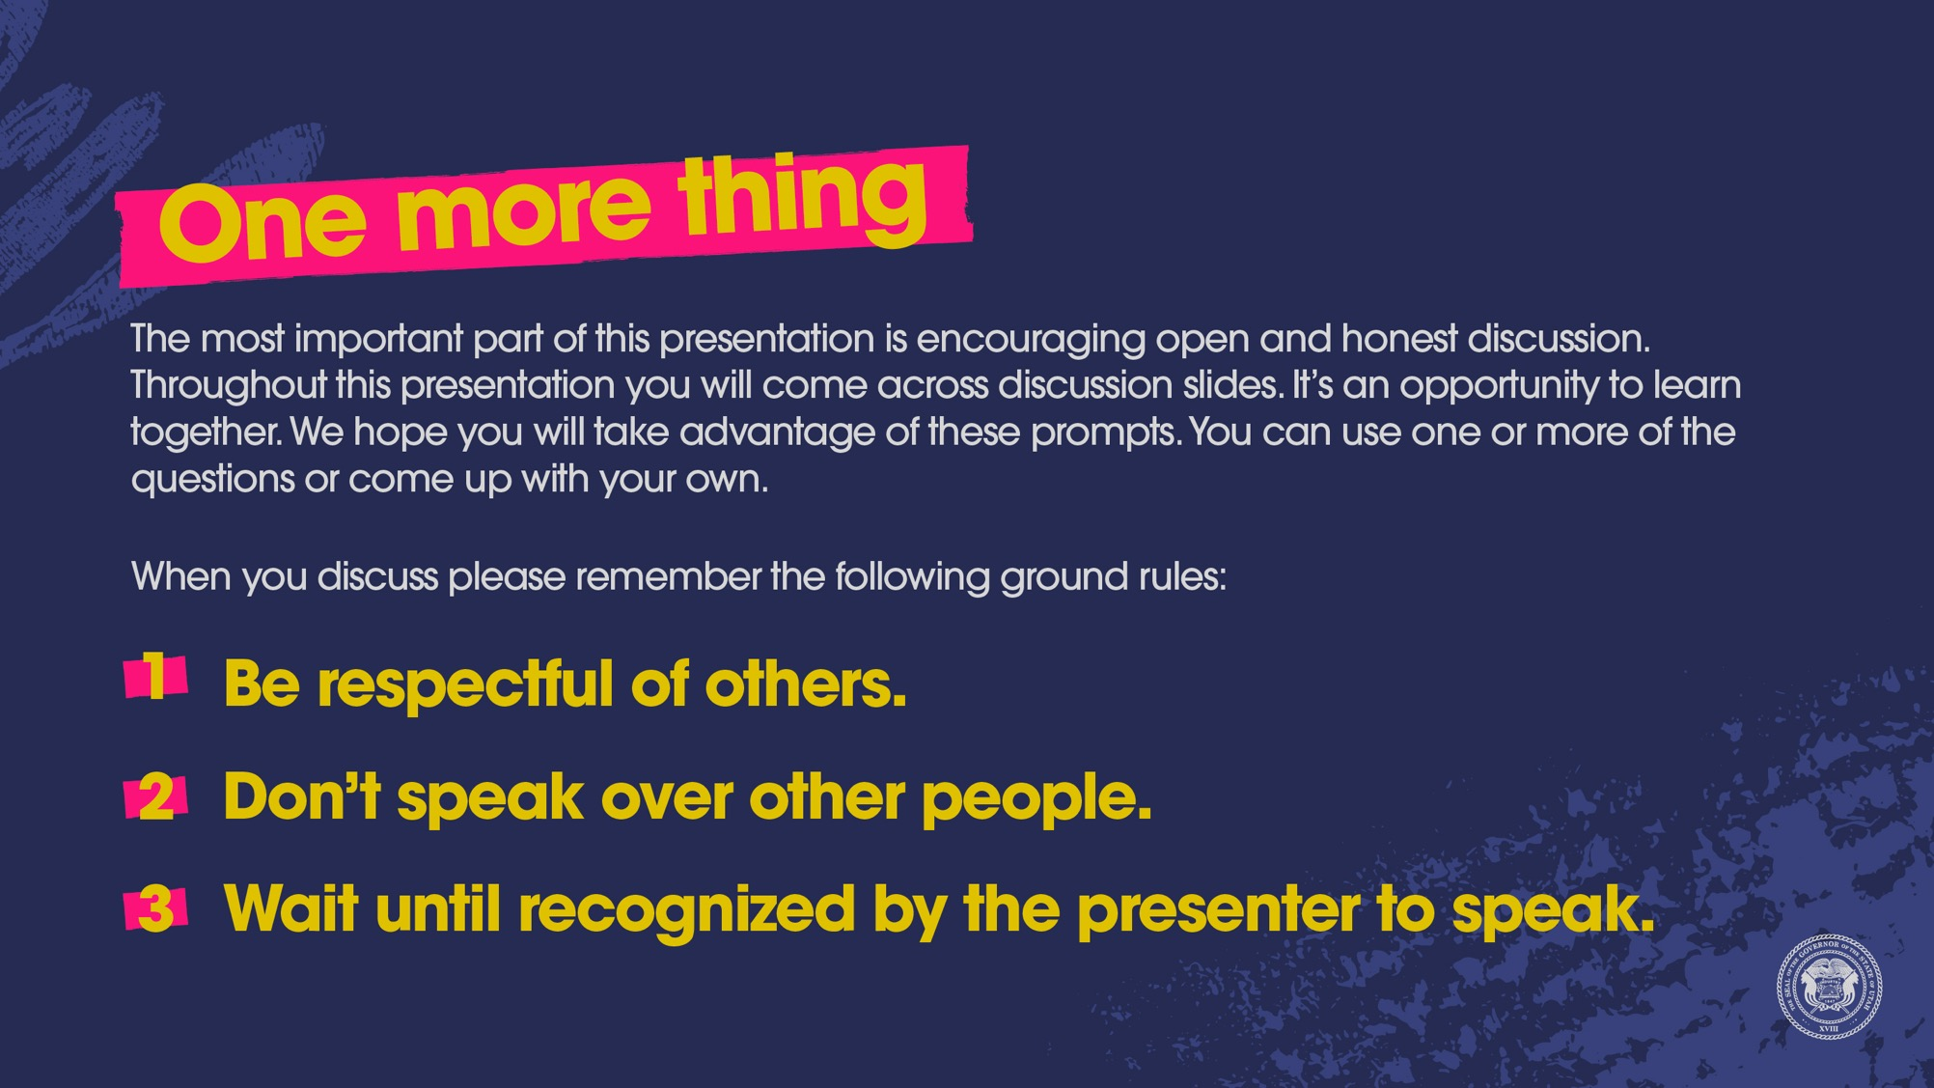

Slide 6

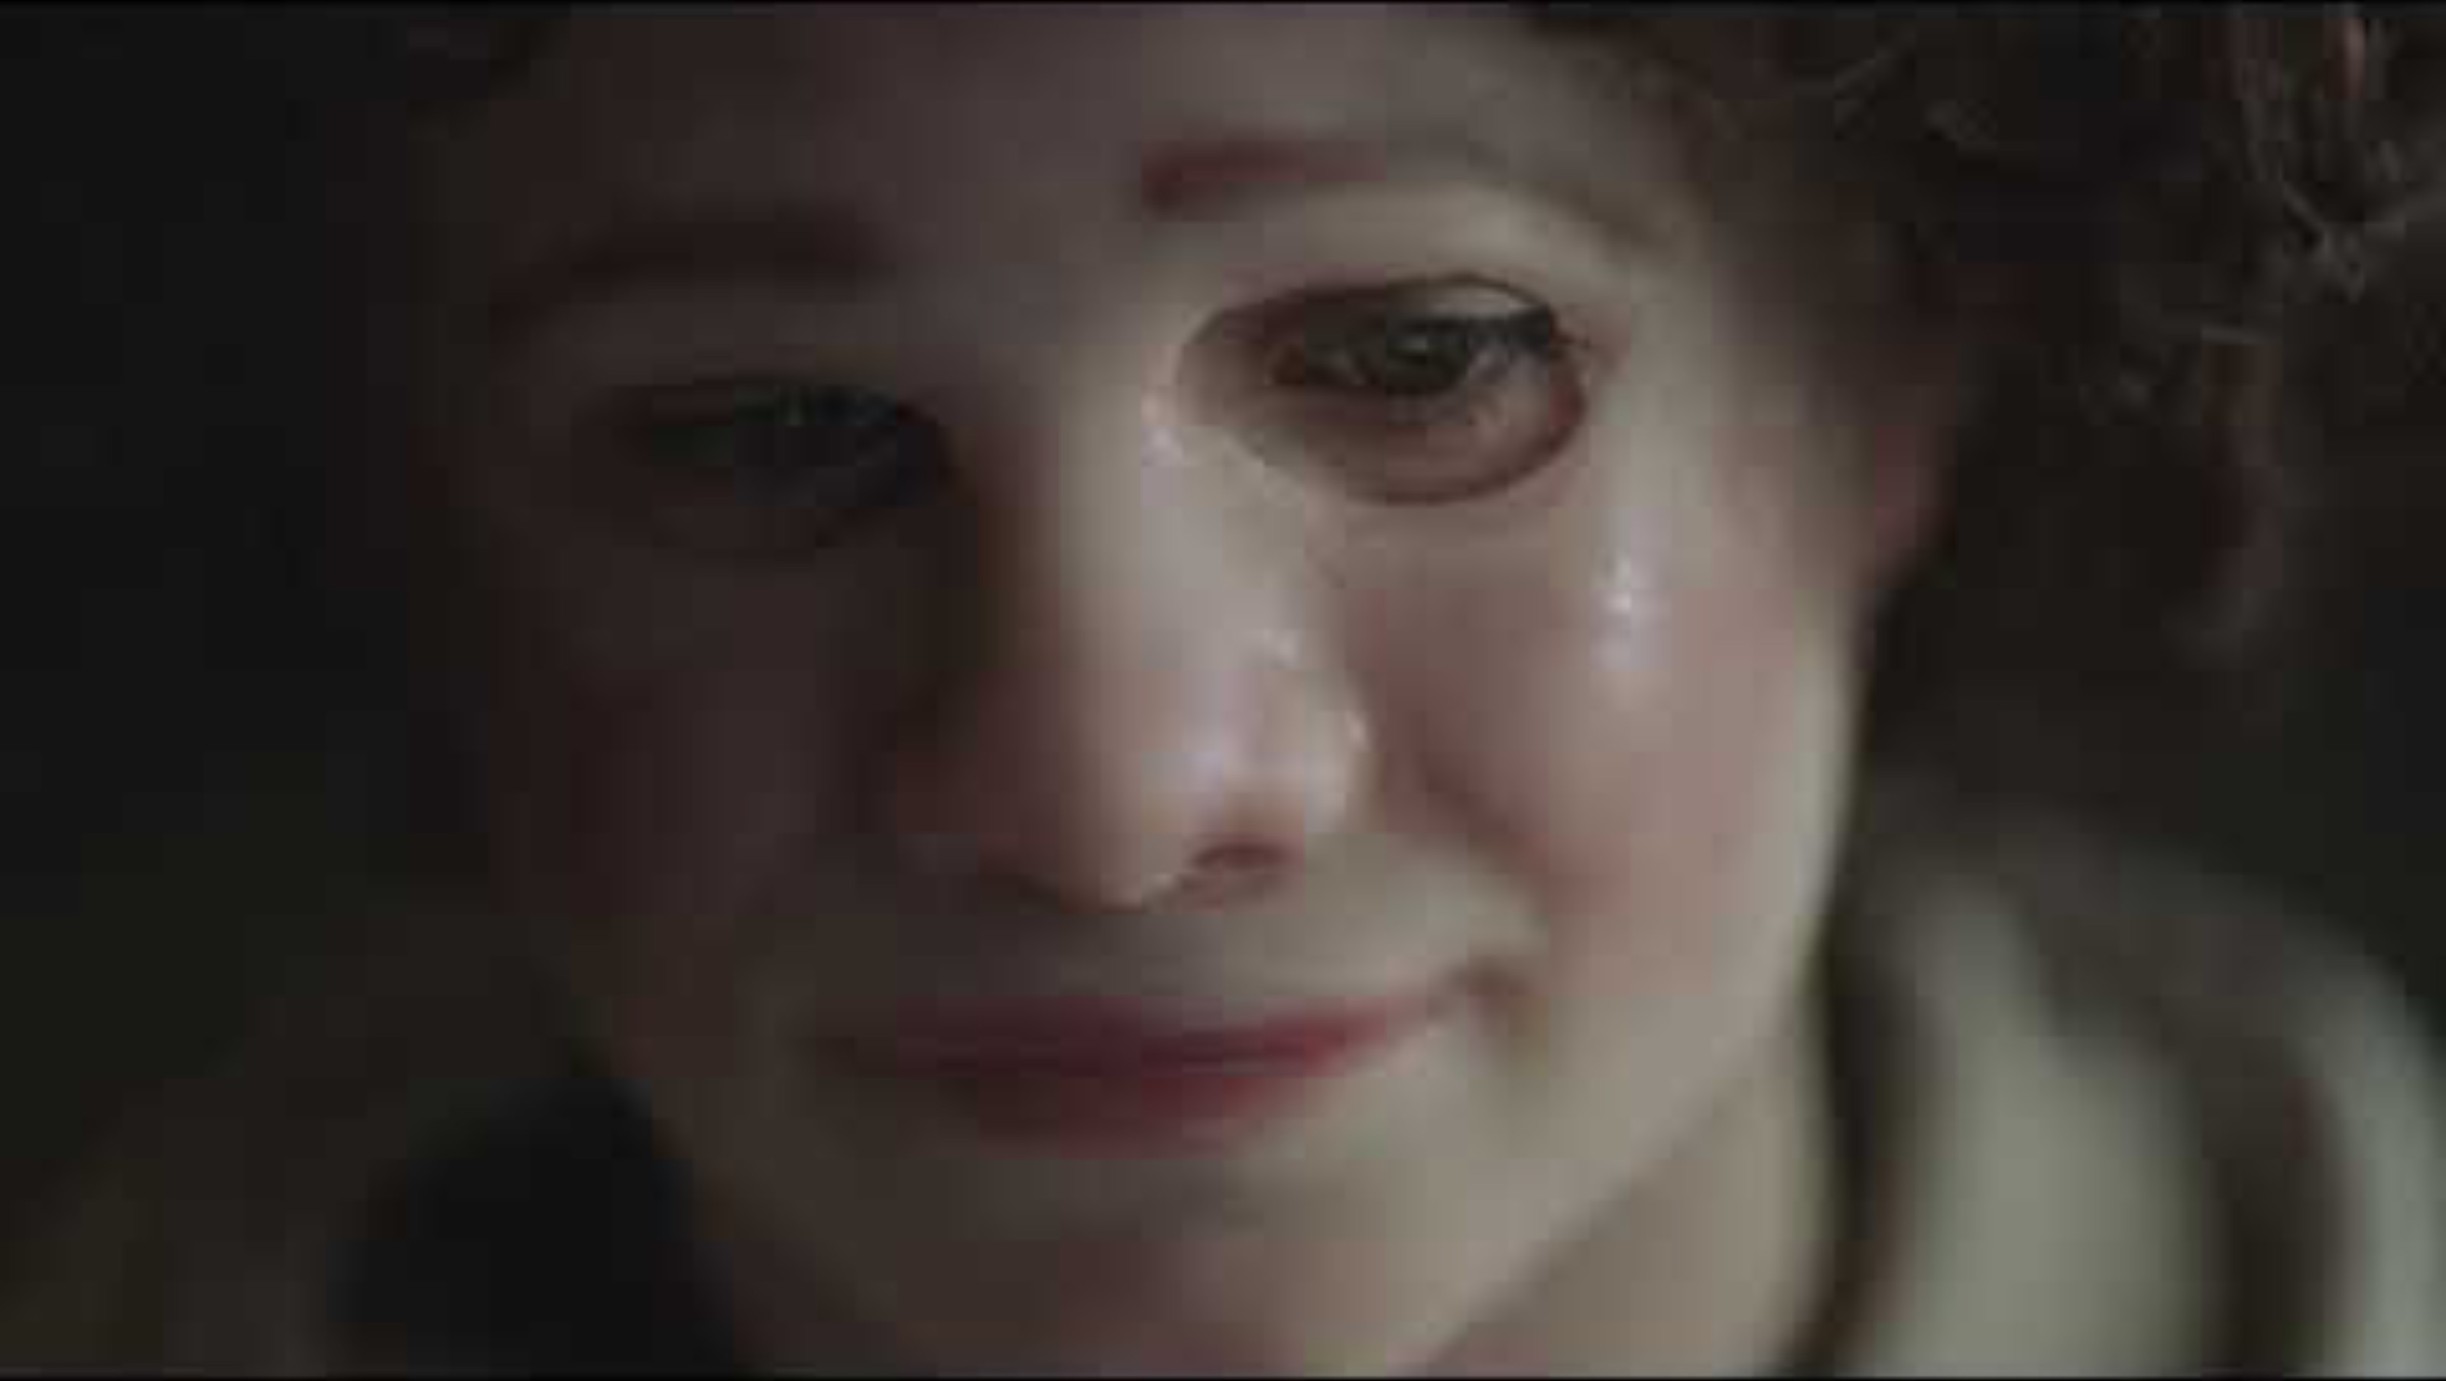

Slide 7

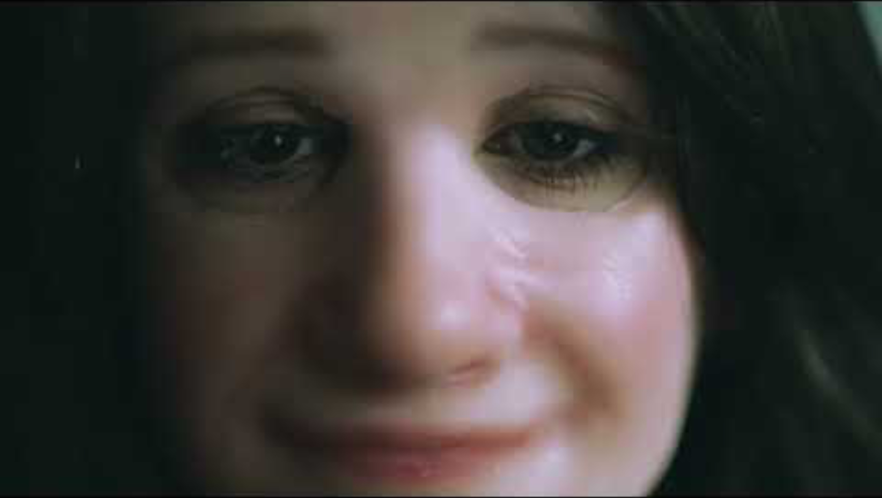

Slide 8

Notes:
YOUTH AUDIENCE: After watching the two videos, pick one or more to discuss.
What did you think of these two videos?
When you receive unkind comments or messages on social media, what do you do?
How does seeing the “perfect” side of friends/celebrities/family members on social media affect you?
How have you seen social media hurt you or your friends?
ADULT AUDIENCE: After watching the two videos, pick one or more to discuss.
What did you think of these two videos?
What harm have you seen social media cause youth recently?
How does seeing the “perfect” side of friends/celebrities/family members on social media affect youth?
What are your top concerns when it comes to youth and social media?

Slide 9
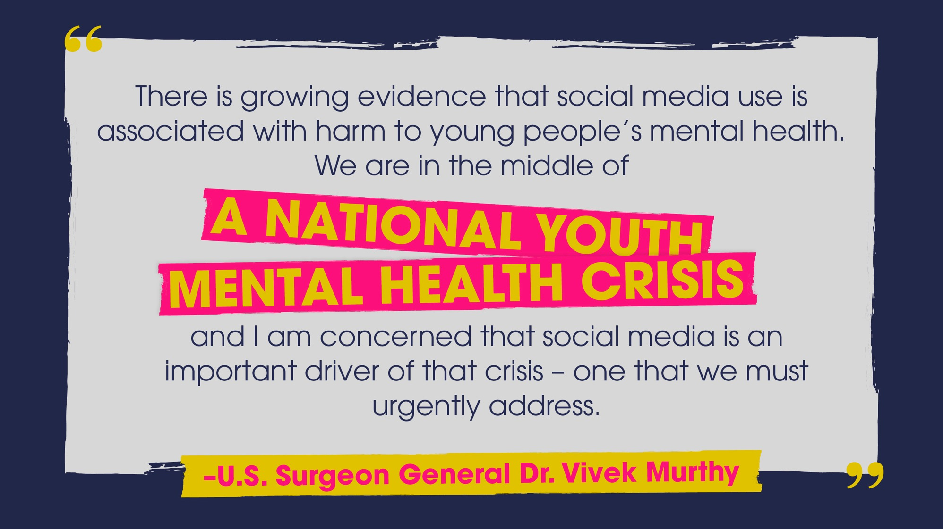

Slide 10
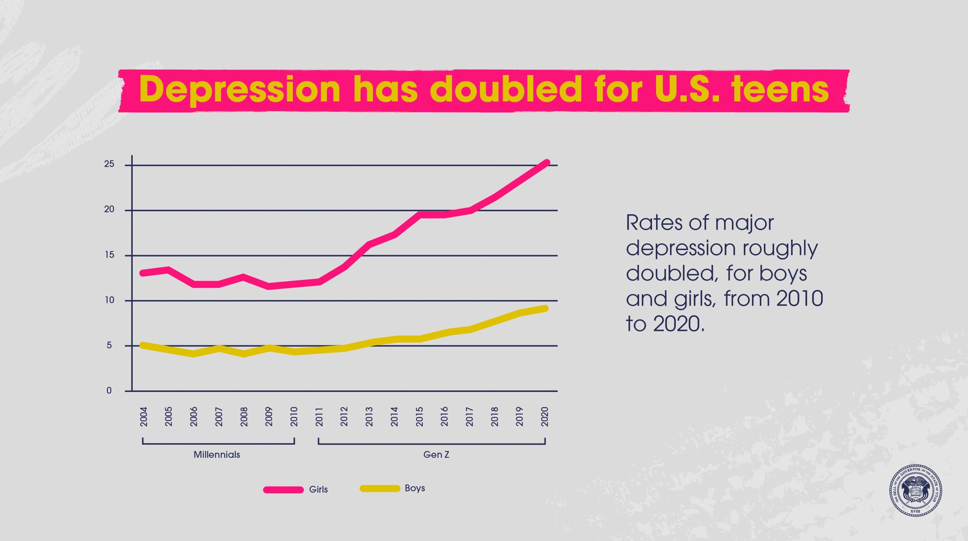

Slide 11
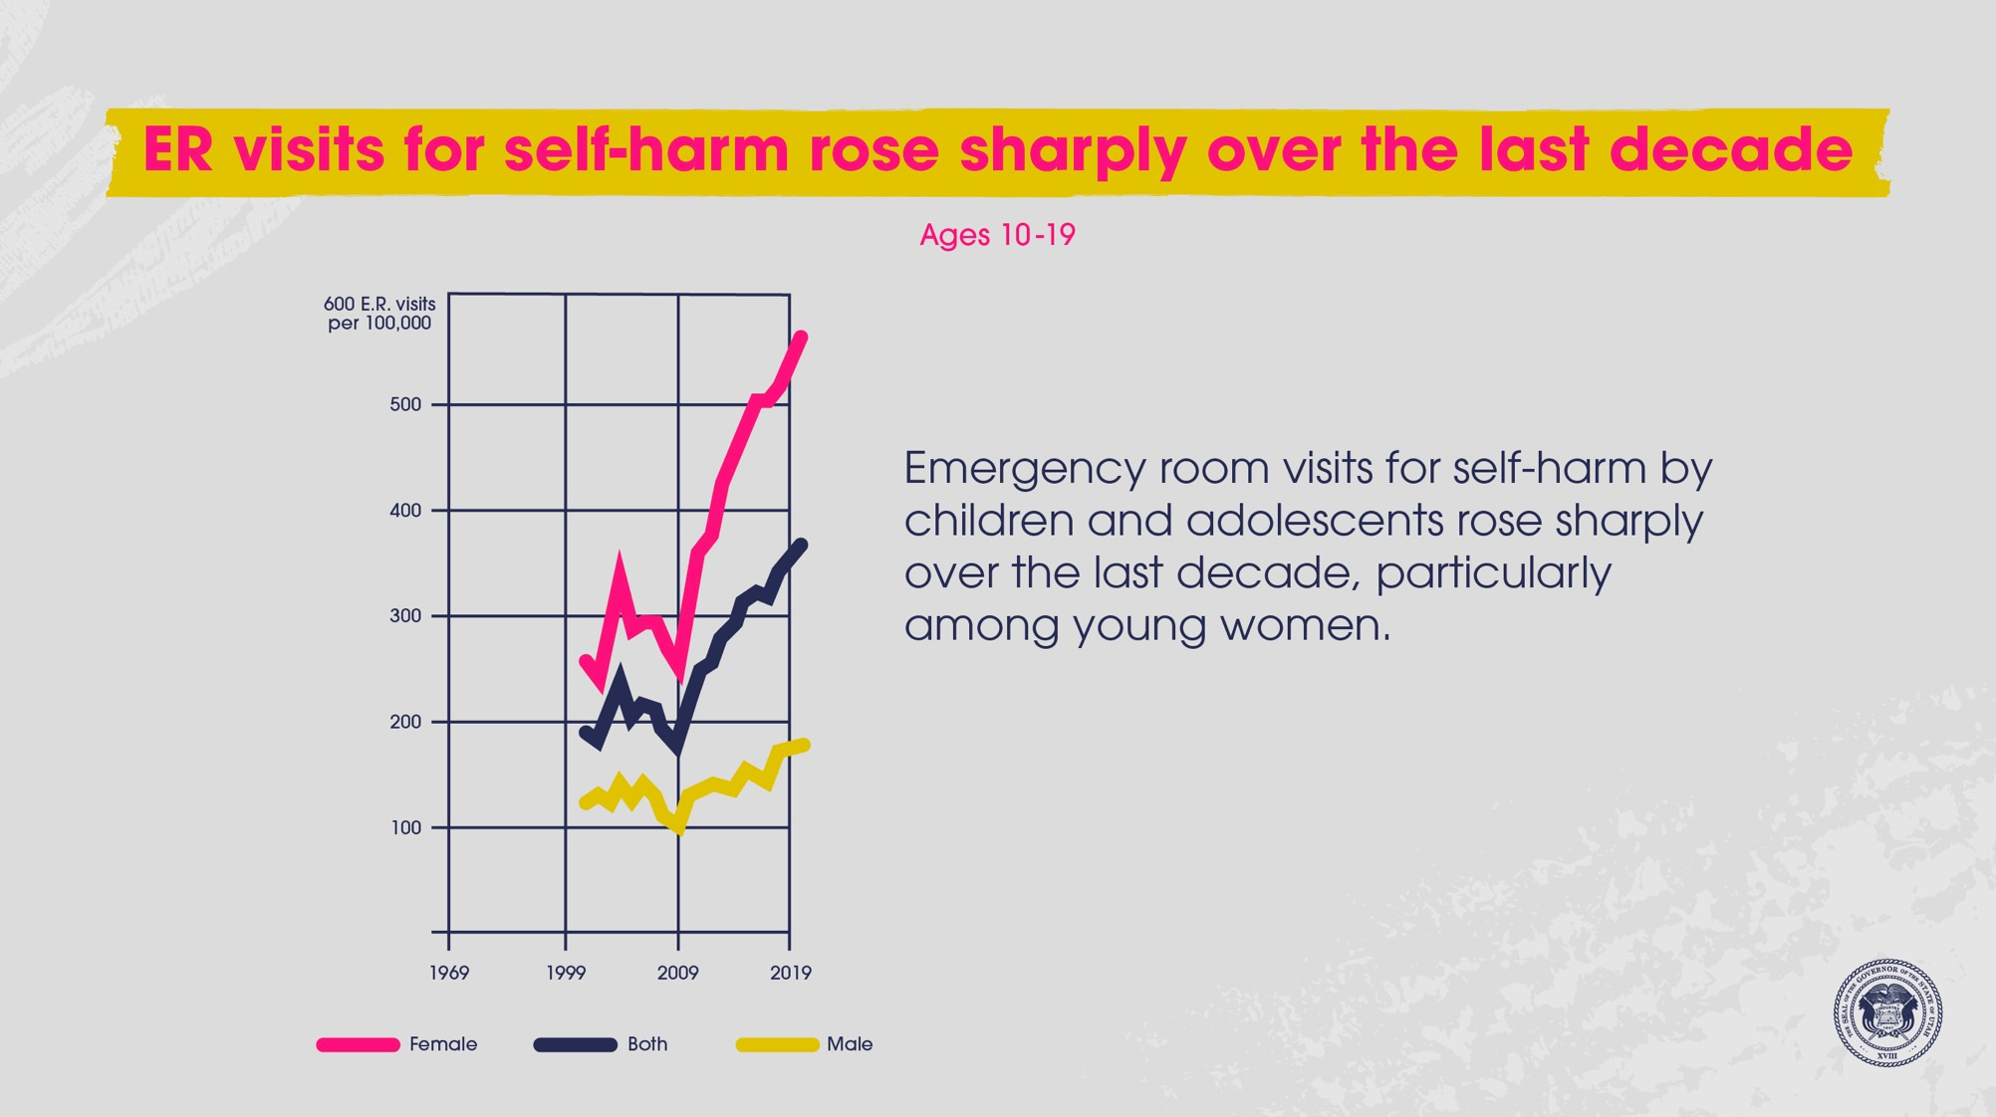

Slide 12
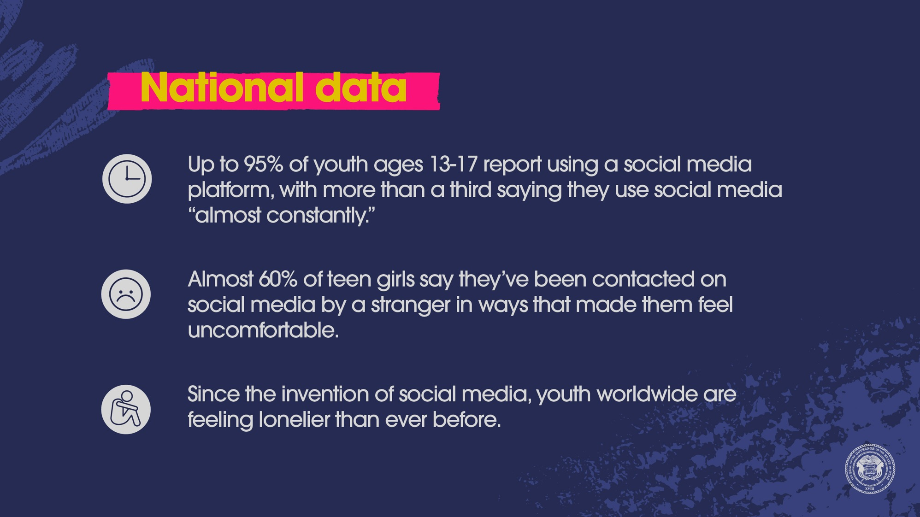

Slide 13
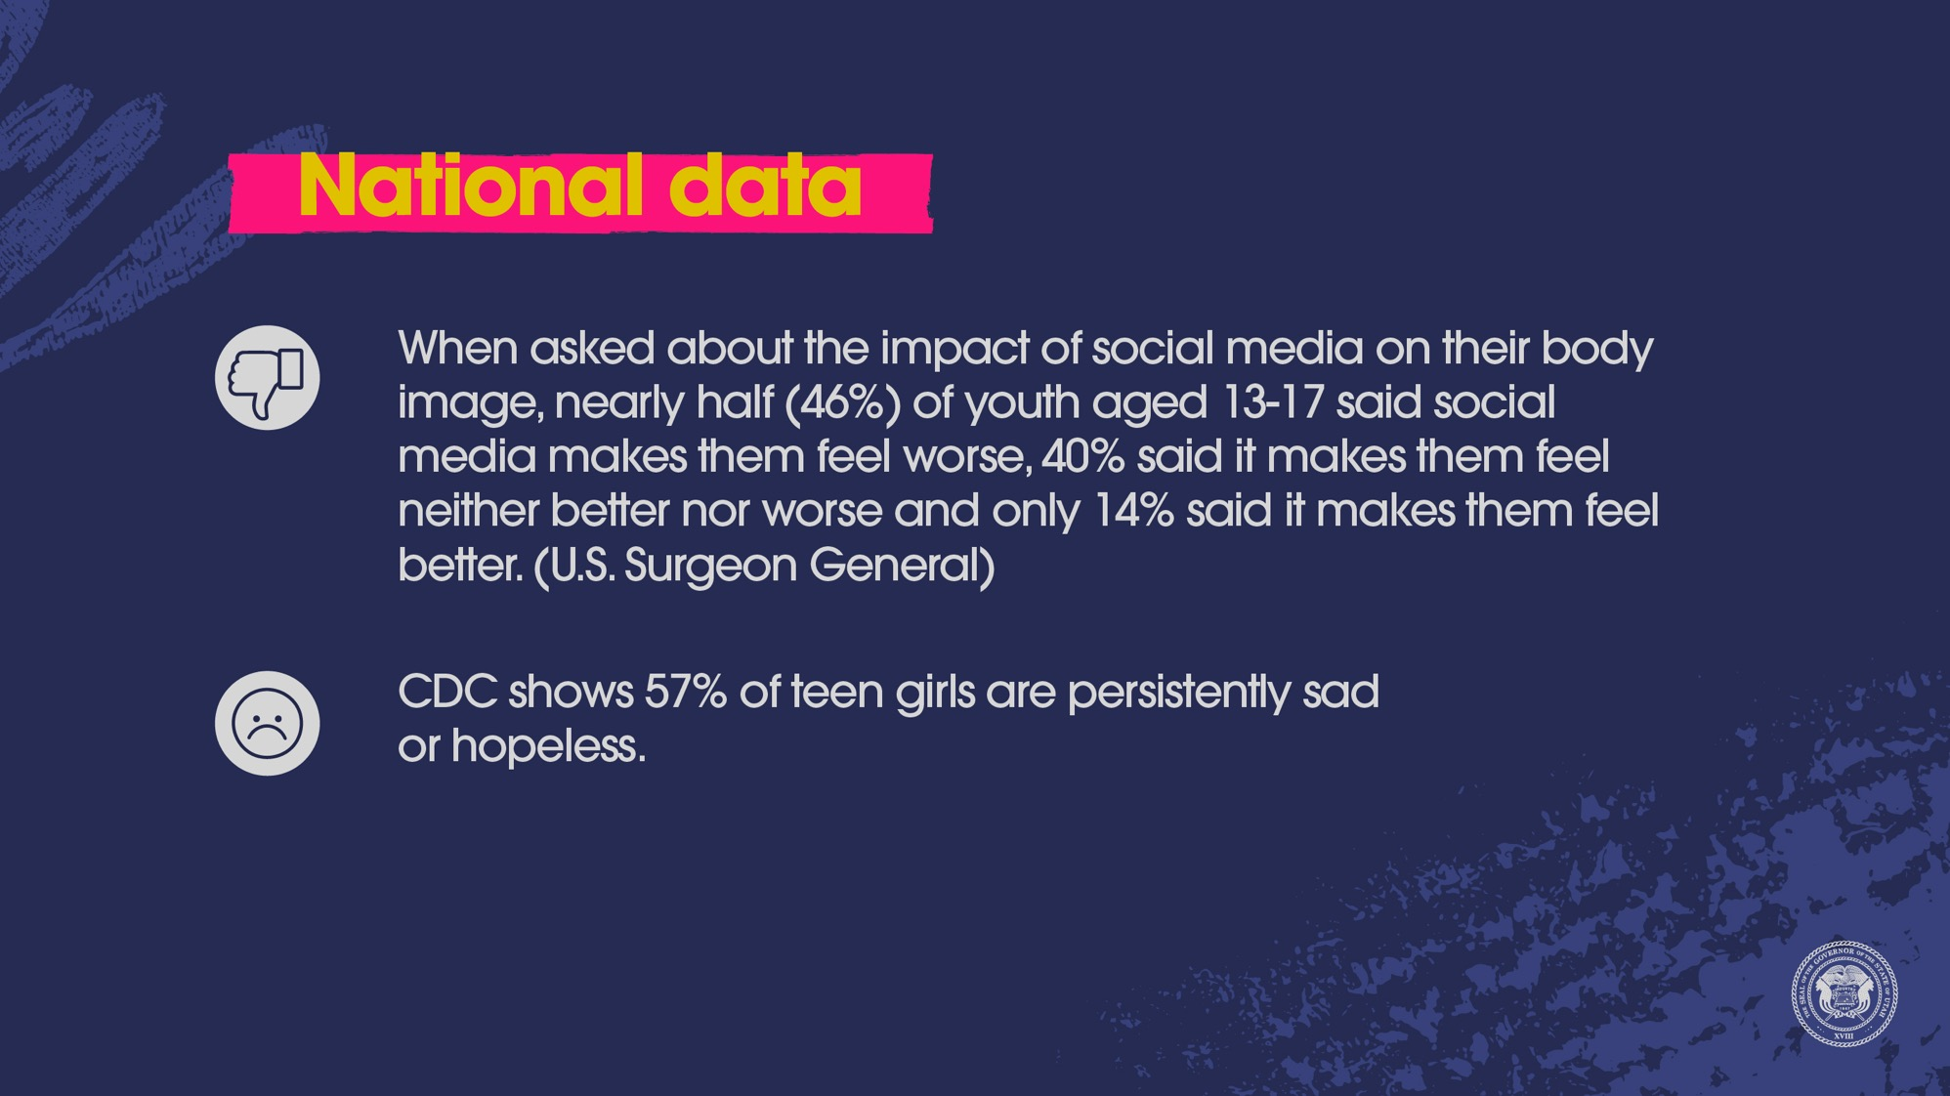

Slide 14
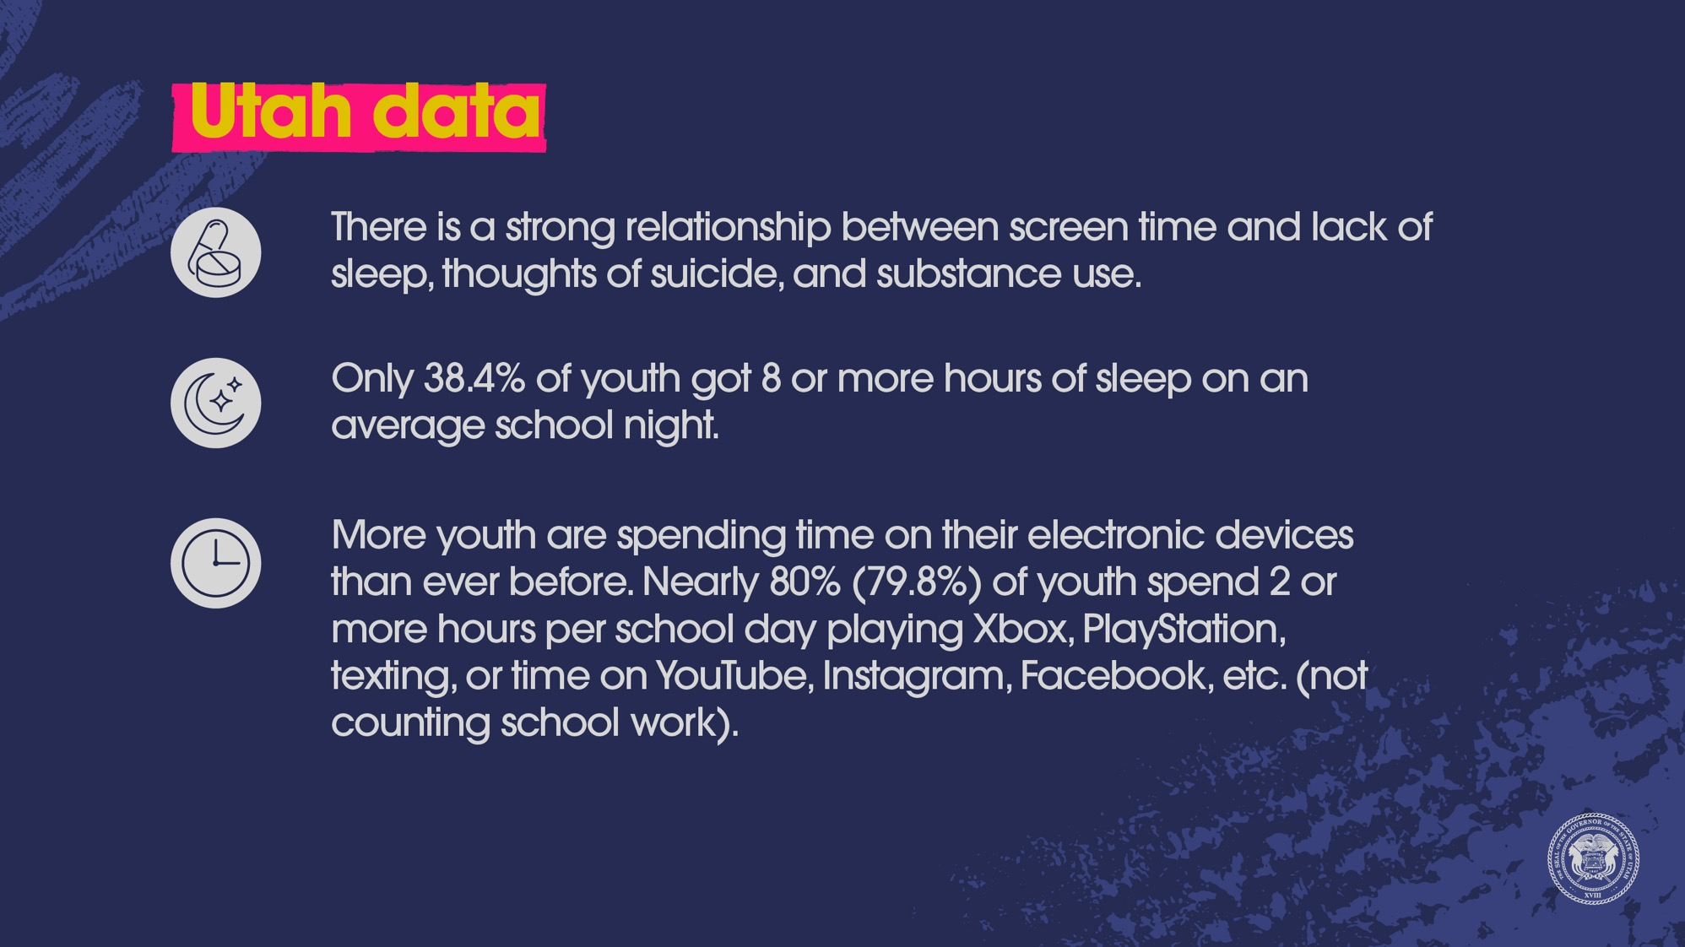

Slide 15
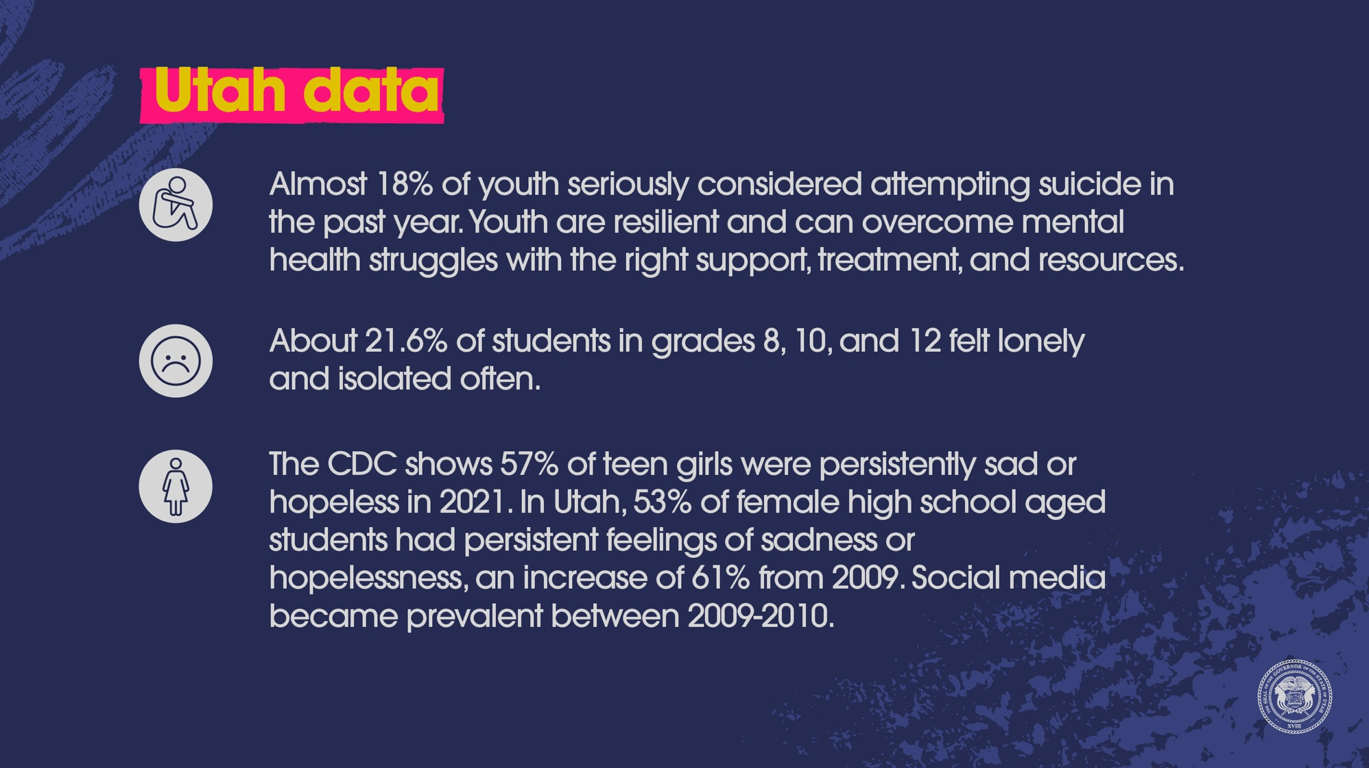

Slide 16
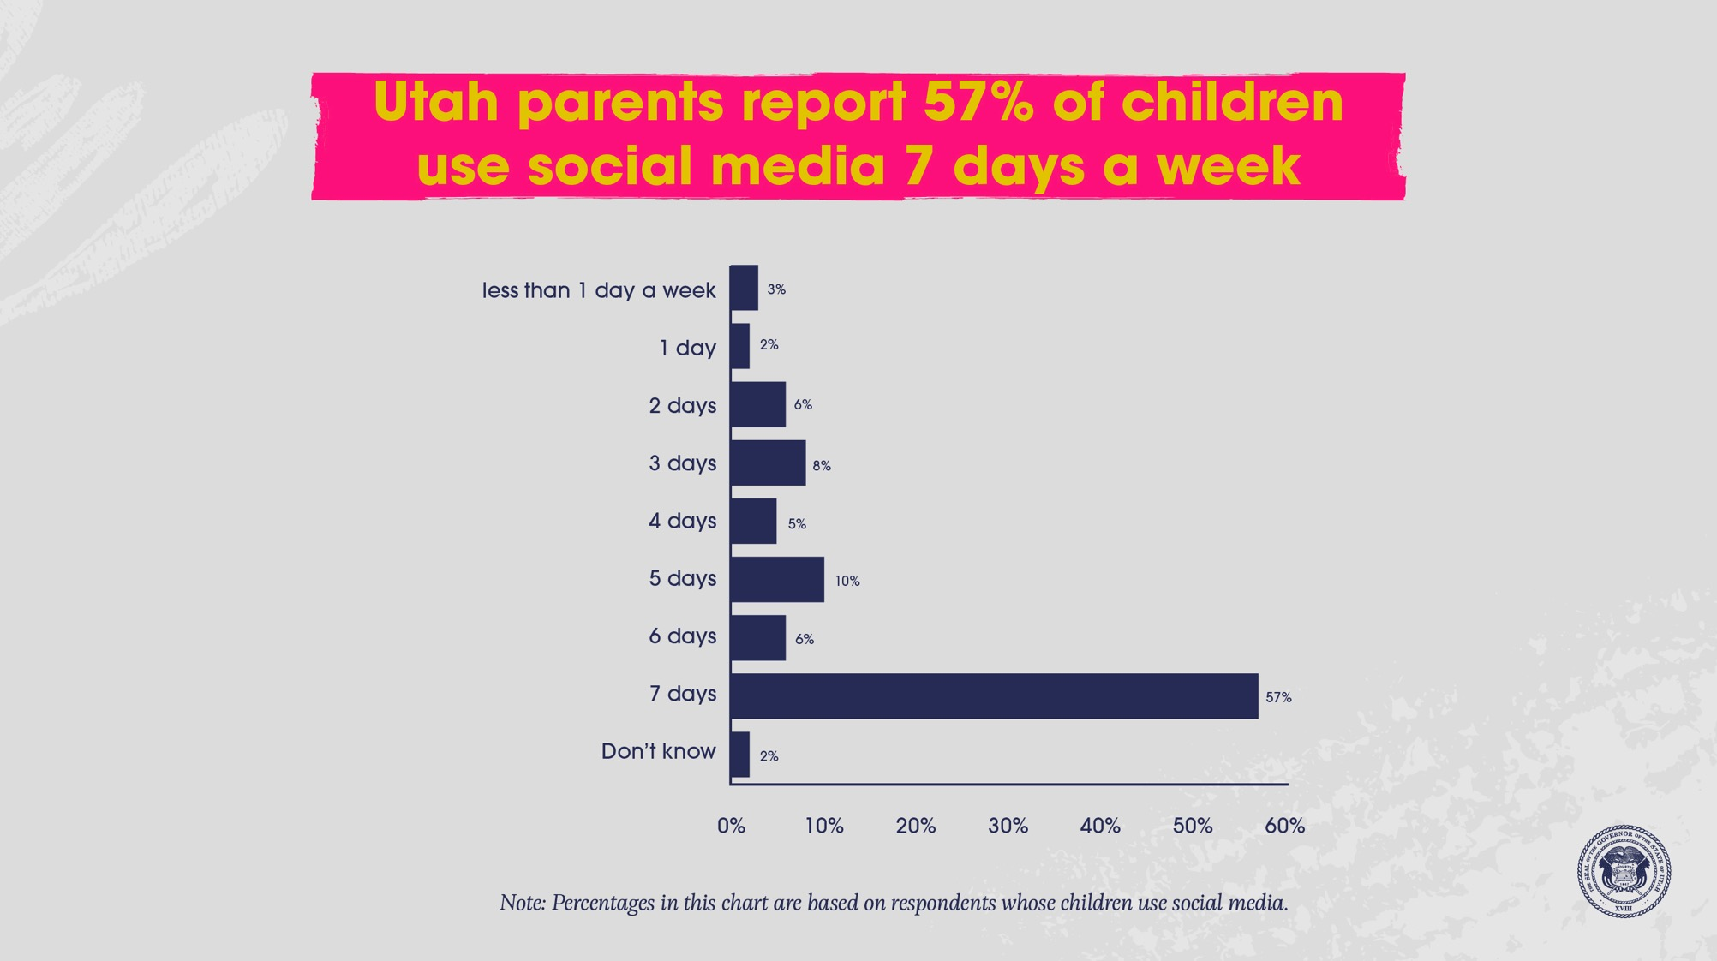

Slide 17
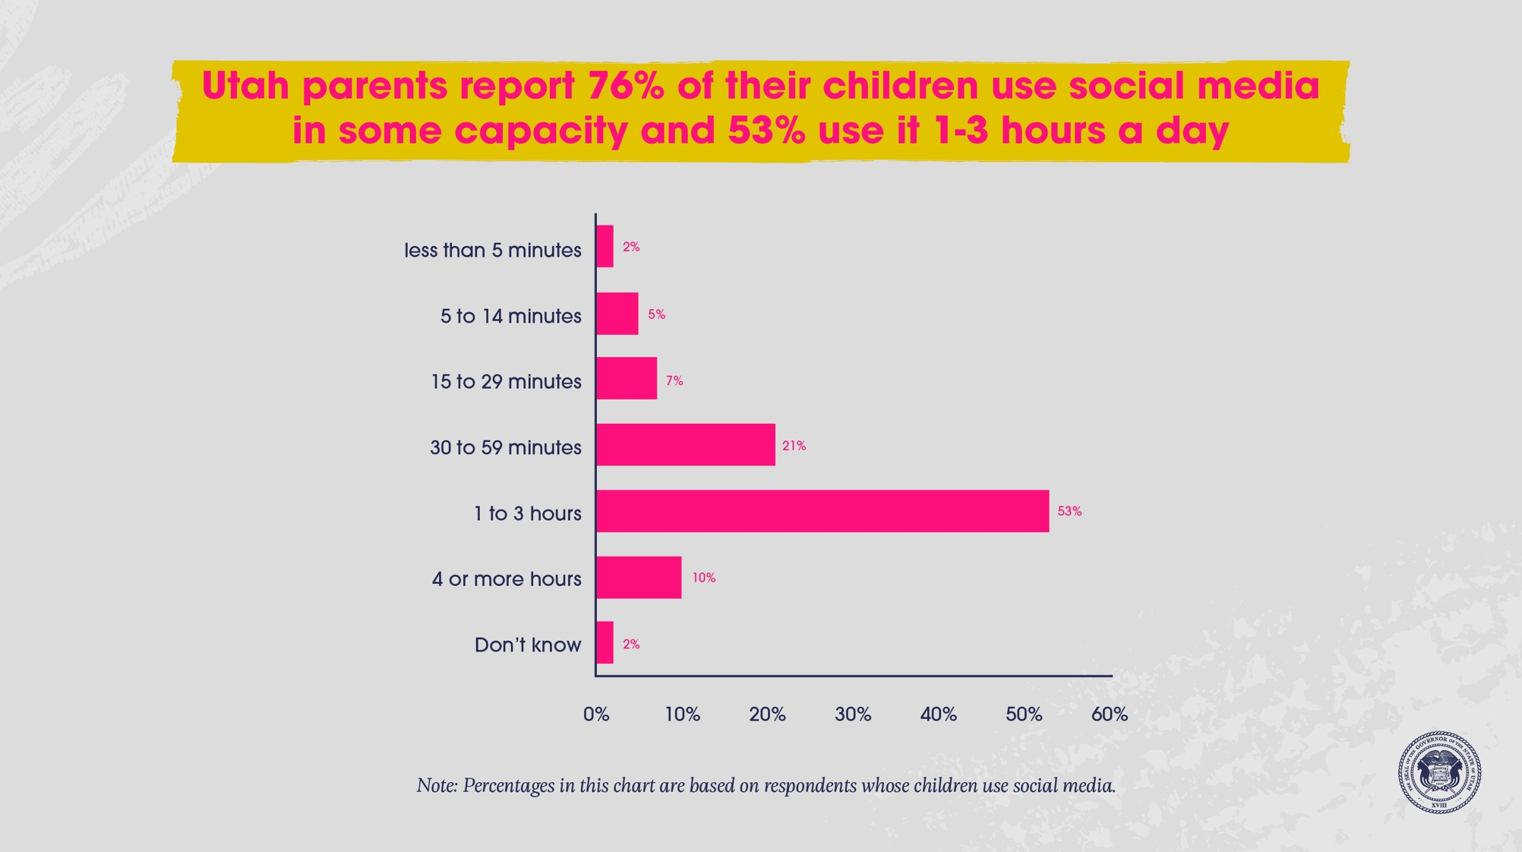

Slide 18
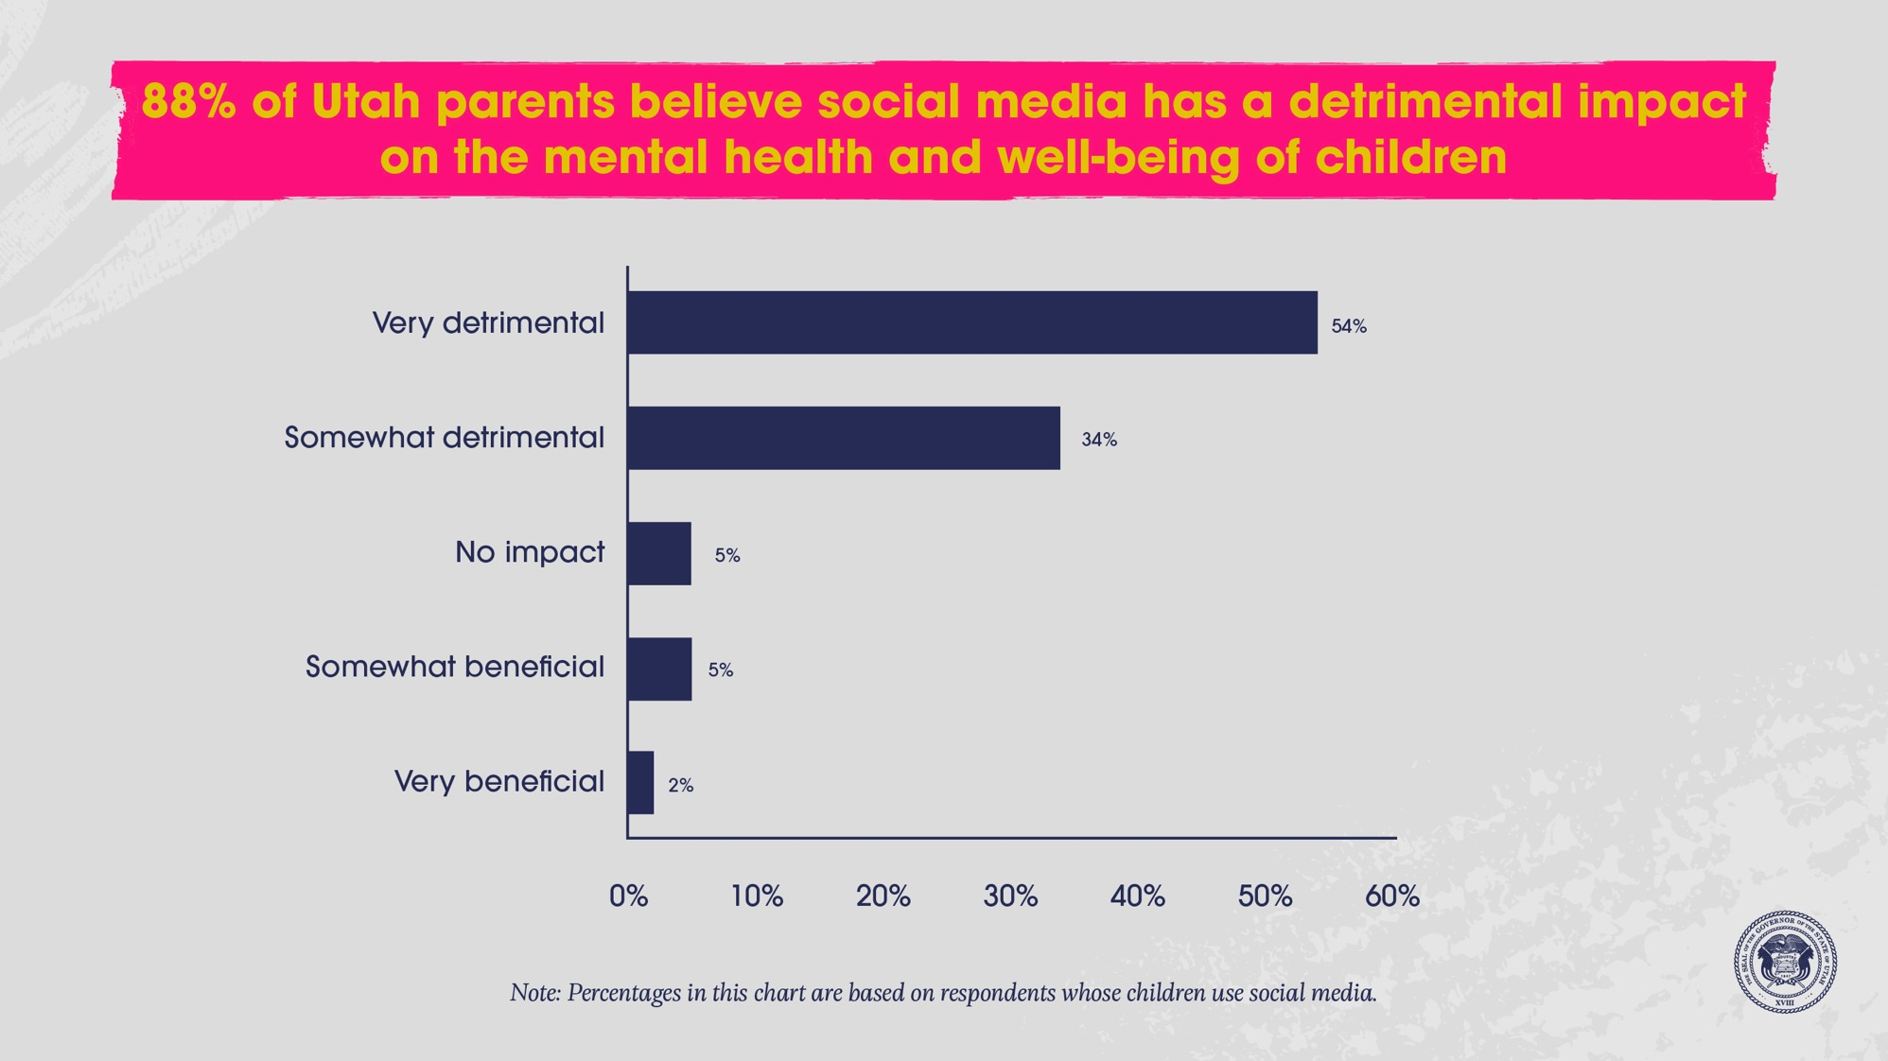

Slide 19

Notes:
YOUTH AUDIENCE: pick one or more to discuss.
What are your thoughts after hearing this data?
Raise your hand if you or someone you know has experienced any of the harms mentioned in the data? (loneliness, hopelessness, loss of sleep, negative body image, depression, self-harm, etc.)
What has been your experience with social media?
We want you to be healthy and safe. How can adults better help you when it comes to social media? What are your thoughts and ideas?
ADULT AUDIENCE: pick one or more to discuss.
What are your thoughts after hearing this data?
Do you feel like the situation is better, worse, or exactly as outlined in the data? Explain.
What tools do you want/need to better protect youth from the harms of social media?

Slide 20
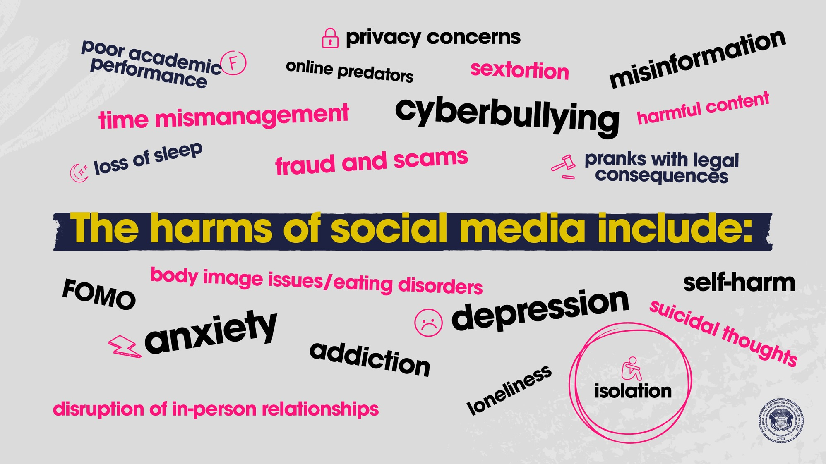

Slide 21
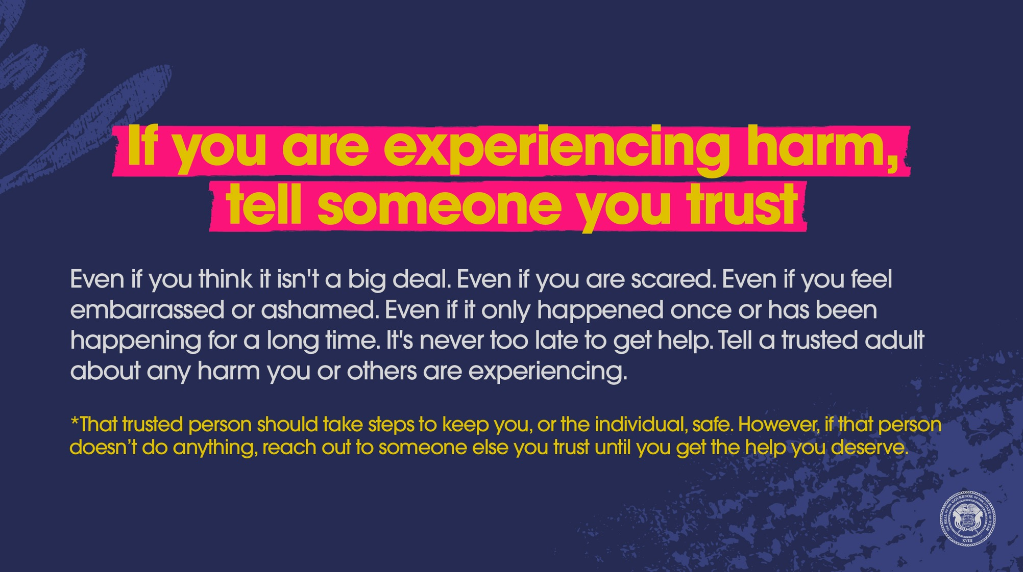

Slide 22

Notes:
YOUTH AUDIENCE:
PROMPT: Think of one or more adults you trust, these are adults you can go to for protection or help. (pause and give the audience time to think --10 seconds)
QUESTION: What else can you do to get help or protection (aside from talking to your trusted adult you thought of)?
ADULT AUDIENCE: pick one or more to discuss.
Do youth know they can come to you for help and protection from the harms of social media? (ADD: It’s important to verbalize often your willingness to help)
How do you get youth to open up about their experiences with social media?

Slide 23
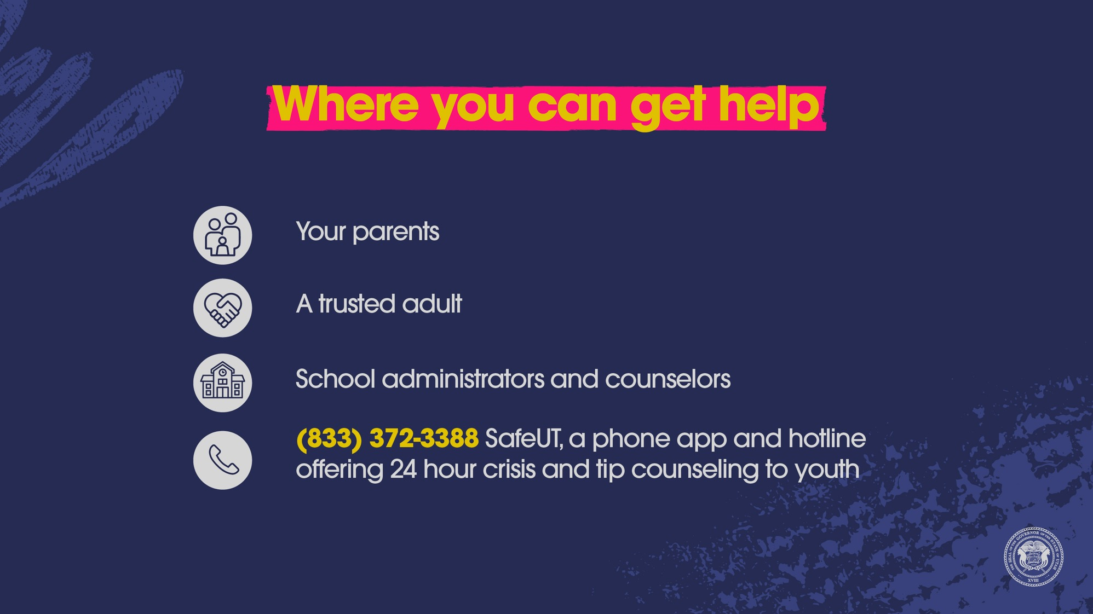

Slide 24
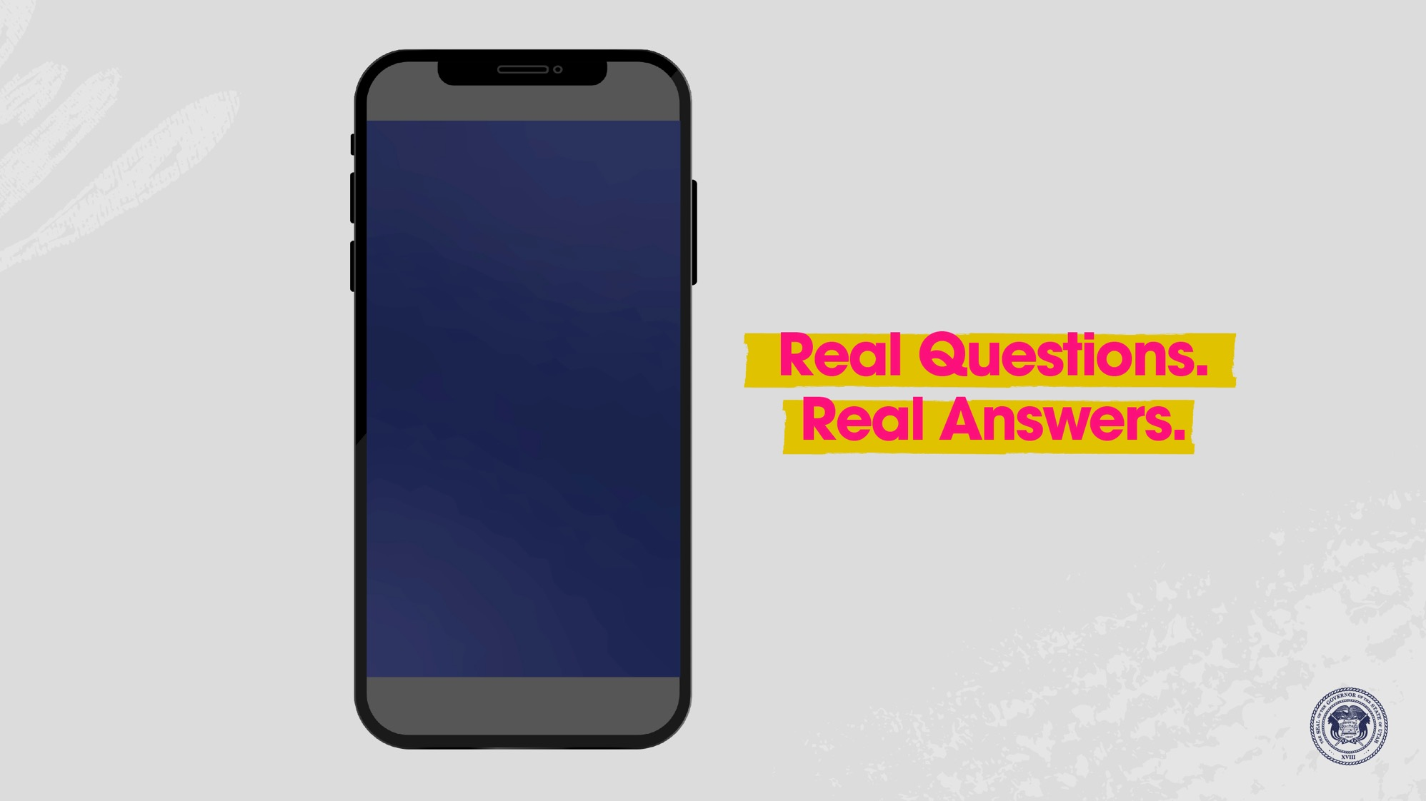


Slide 25
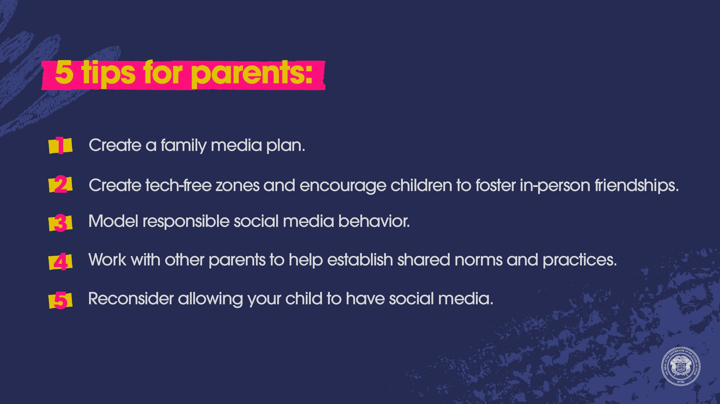

Slide 26
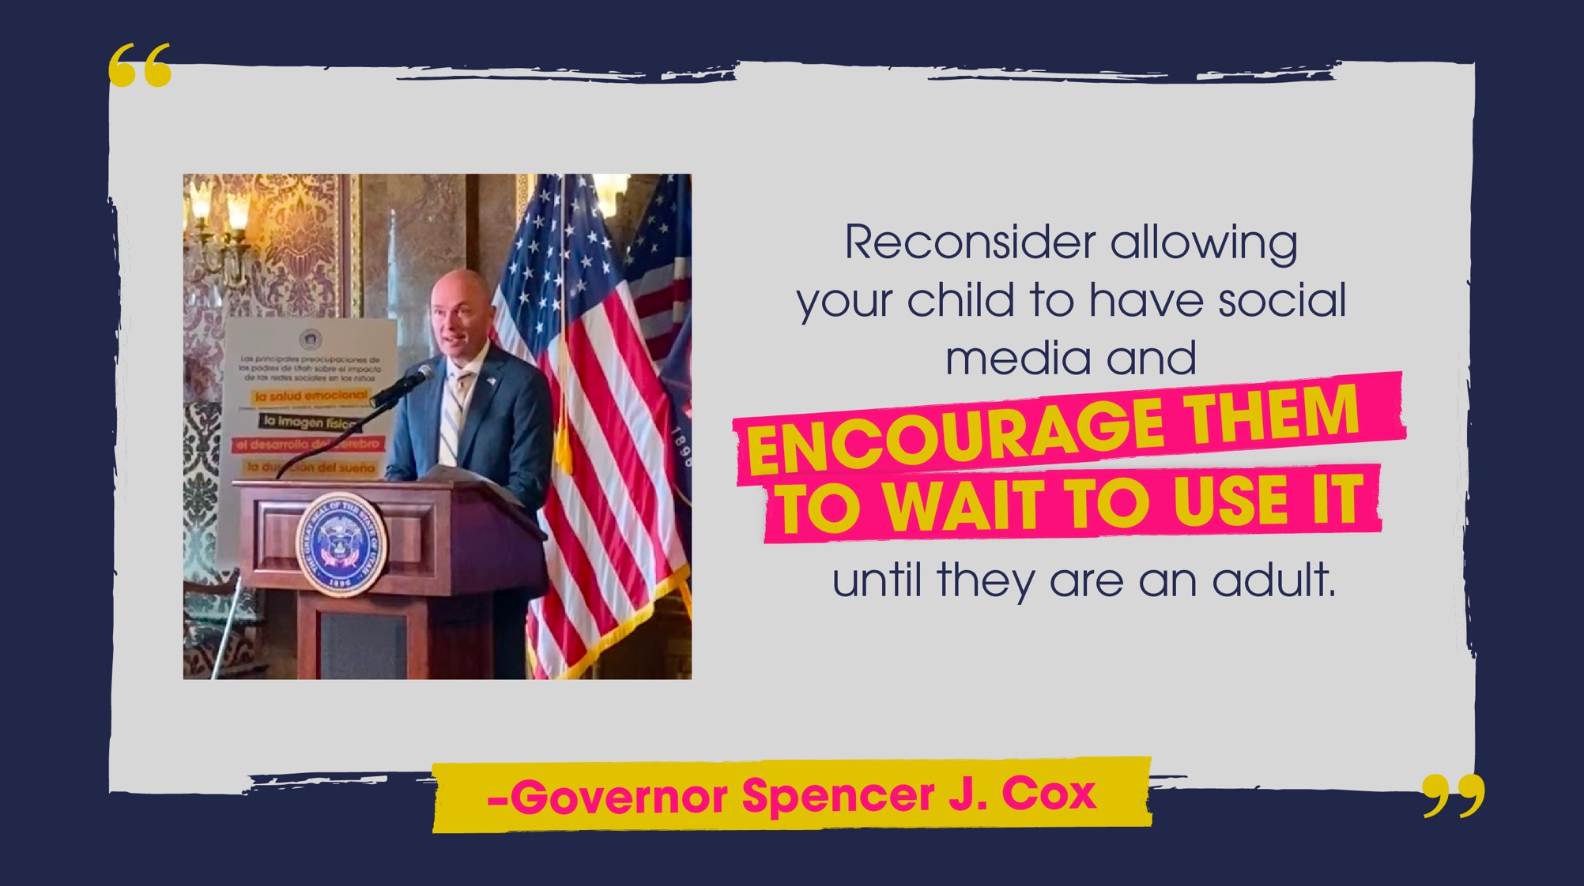

Slide 27
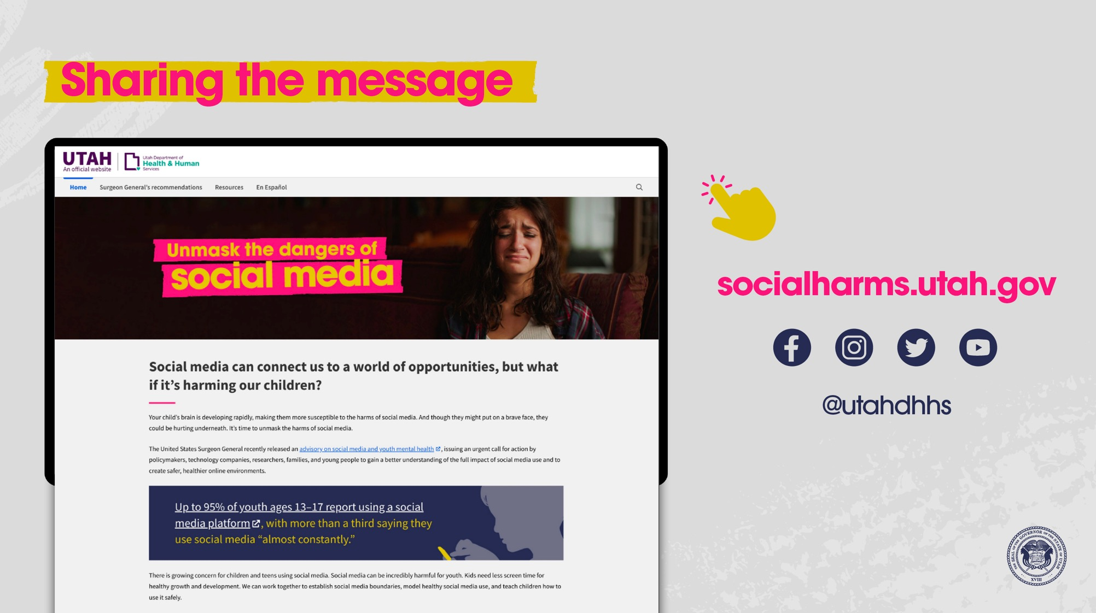

Slide 28
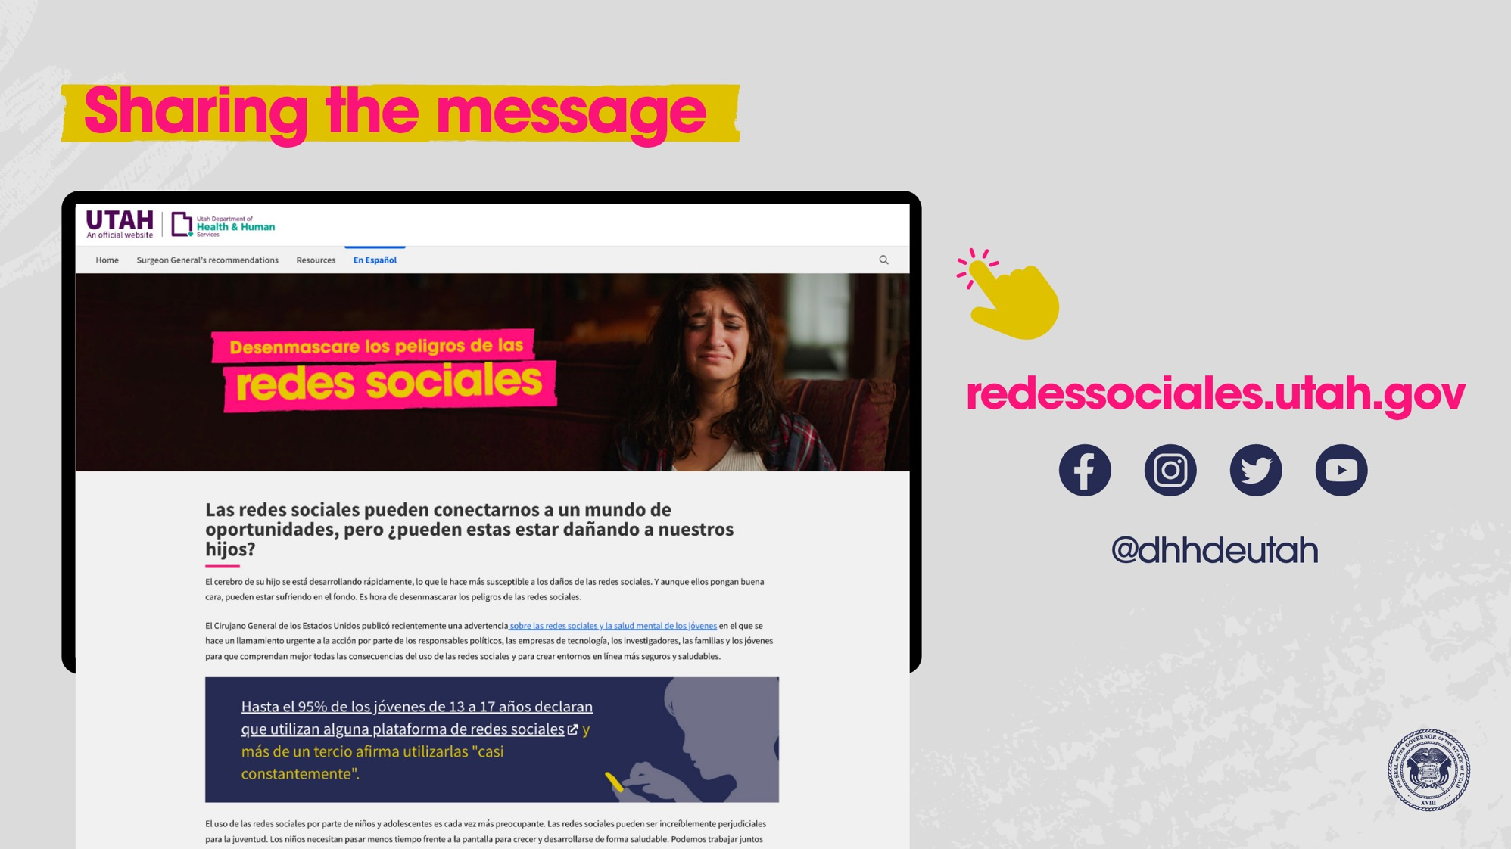

Slide 29
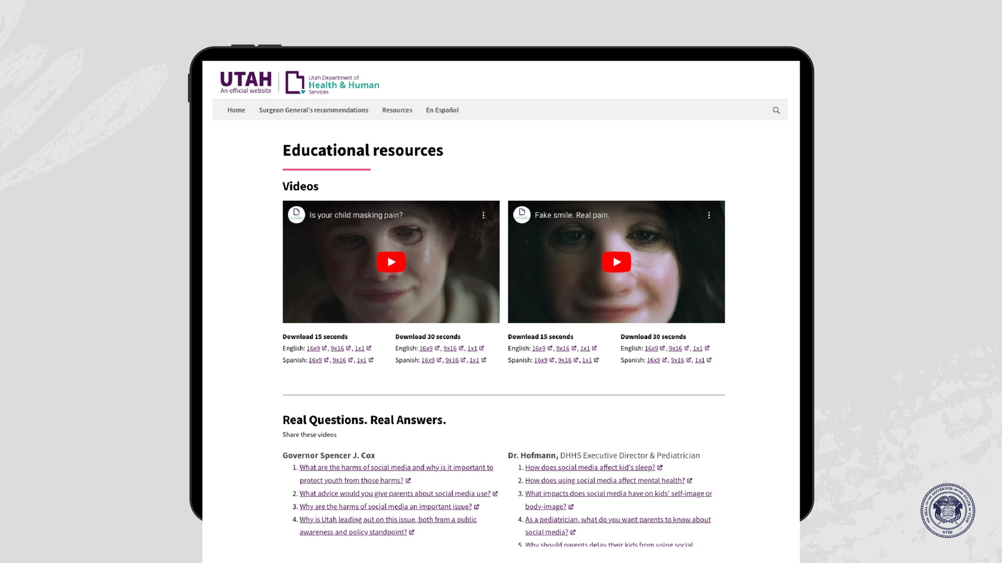

Slide 30
